Slide 1
Sentiment Analysis of Amazon Review
Roman Bellisari, Michael Delcid, Matthew Lepis
CPE 695: Applied Machine Learning

Slide 2


Project Scope
Objective
Determine the sentiment of Amazon user reviews
General Approach
Text Classification & Natural Language Processing (NLP)
Notes:
Matthew Lepis
The primary objective of this project was to determine the sentiment of Amazon user reviews.
Given a piece of text, the team used text classification and NLP to rank the sentiment value of a review on a scale of one to five stars.
This rating was then compared to the actual product rating on Amazon.

Slide 3


The Dataset
Source
Originally: SNAP (Stanford Network Analysis Project)
~35 million samples from June 1995 to March 2013
Derived: Registry of Open Data on AWS
Reduced to 3.65 million samples; equally distributed between star ratings 1 through 5.
Dataset Features
Class index (star rating) [1 to 5]
Review title
Review text
Notes:
Matthew Lepis
The dataset we chose to achieve this objective, was an amazon review dataset from SNAP.
The SNAP dataset had around 35 millions review samples from 1995 to 2013.
This amount of data wasn’t necessary for our task, so we sought to reduce it.
This brought us the dataset that we actually ended up using. It was from the ‘Registry of Open Data, on AWS’.
They had reduced the size of the SNAP dataset by 90%, which brought the size to around 3 and a half million samples.
They also ensured that there was an equal number of samples per star rating, and this helped us down the line during processing.
While there were a bunch of miscellaneous features included in these datasets, we only needed a few and those were the Star Rating, the Review Title, and the Review text itself

Slide 4
NLP Developments
Transfer Learning
Multilingual NLP
Automating Customer Service
Notes:
Mike
Transfer learning - train a model for one task and repurpose for another task. Side steps training models from scratch and allows businesses to complete NLP tasks faster using smaller amounts of data
Multilingual NLP - Mpst NLP advances are focused on English. In the future a multilingual machine translation model can be used to translate 100 languages without relying on english data
Automating customer service - Chatbots play a significant role on the frontline of customer service. Advancements will allow chatbots to hold more complex conversations, and learn how to complete new tasks without previous training

Slide 5
Known Solutions
In previous works, researchers identified the positive or negative semantic orientation of adjectives within a collection of text. The researchers achieved high precision in classifying this word class.
In another related project, researchers identified product features by analyzing customer opinions and ranking them by frequency. This type of NLP was used to isolate key features of a product.
In a paper released by NYU, researchers utilized CNN for text classification. The researchers achieved high accuracy without spending large amount of time on preprocessing data.
Notes:
Mike

Slide 6
Our Solution
We retrieve the semantic orientation for more than one class of word and accurately tokenize them to use in the sentence analysis of product reviews
The team mines product features in reviews for the purpose of classifying them within a five star ranking system
These ratings are then compared against the actual rating of the product and will be used to distinguish between real and fake reviews left by customers
Notes:
Mike
Our approach is similar to Hatzivassiloglou and McKeown[1] in that we are retrieving semantic orientation of adjectives, but are not limiting ourselves to one word class. Our purpose in determining the semantic orientation of word classes is to accurately tokenize words that will be used in the sentence analysis of product reviews
Our team will be mining for product features in reviews for the purpose of classifying it within a five star ranking system and then using these rankings to predict the actual rating of the product. This way lay the groundwork for distinguishing between real and fake reviews left by customers on a given product.

Slide 7
ML Techniques Used
Random Forest
Ensemble Learning
Multi Layer Perceptron (MLP) Artificial Neural Network (ANN)
Overfitting Reduction
Dimensionality Reduction: Principal Component Analysis
Dropout Layers
L2 Regularization
Learning Rating Optimization
Model Evaluation & Prediction Generation
Notes:
Roman

Slide 8









Technologies Used
Notes:
Roman

Slide 9
NLP Processing
Output Class Distribution Leveling
Language Detection
Space Removal
Foreign Character Removal
Stop Word Removal
Punctuation Removal
Case Transformation
Tokenization
Lemmatization
POS Processing
Vectorization
Gensim vs Keras
Notes:
Roman

Slide 10
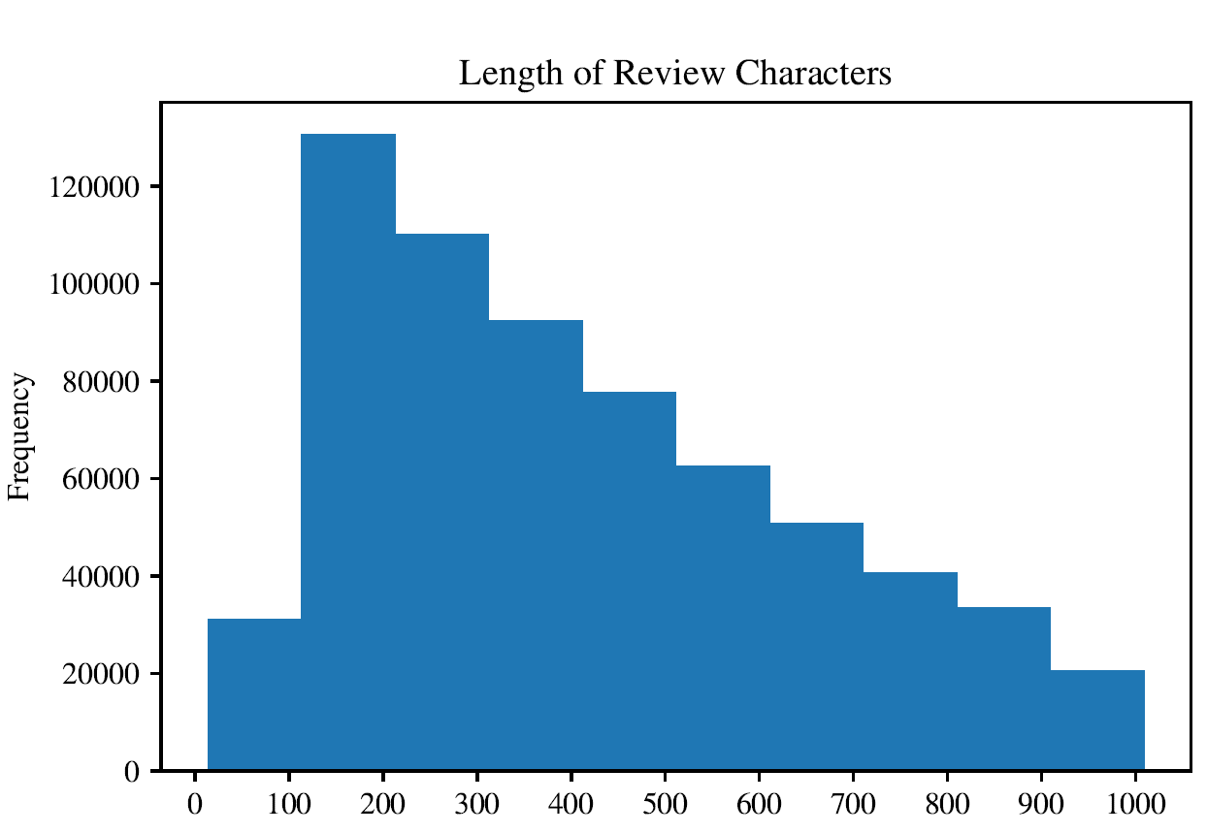
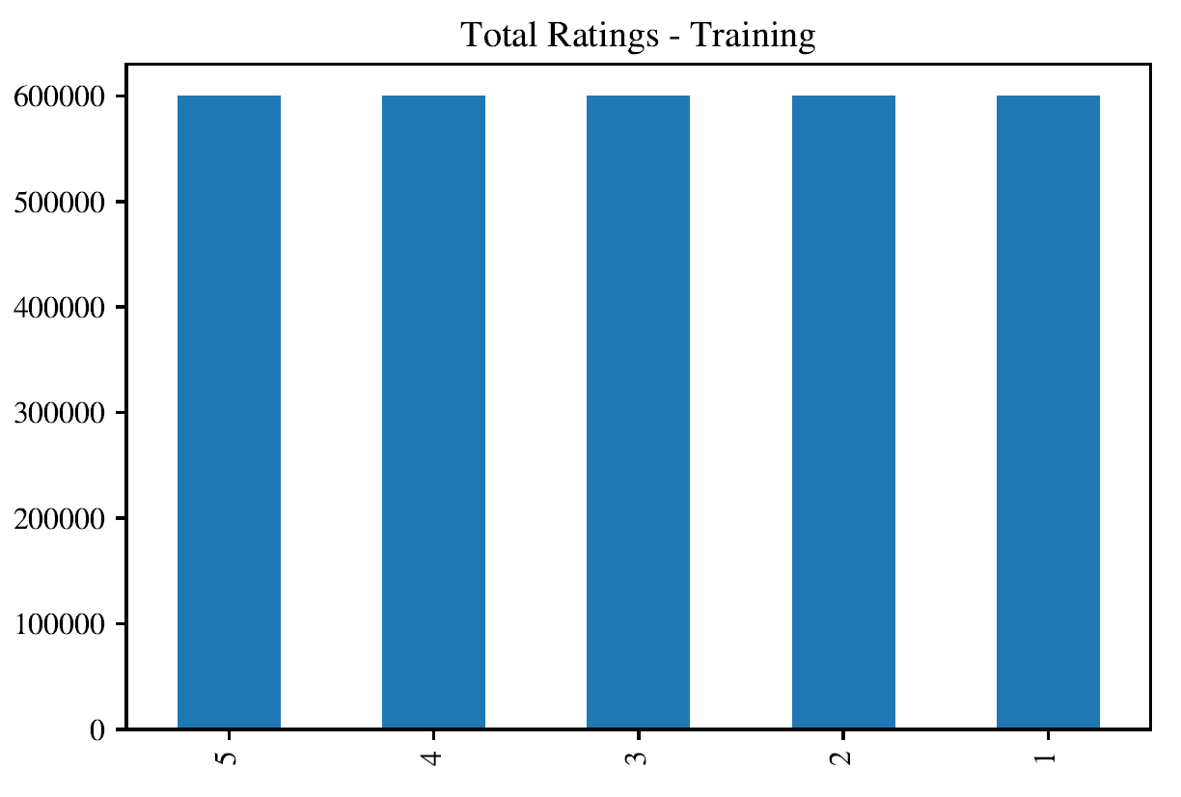
Results
Notes:
Roman

Slide 11
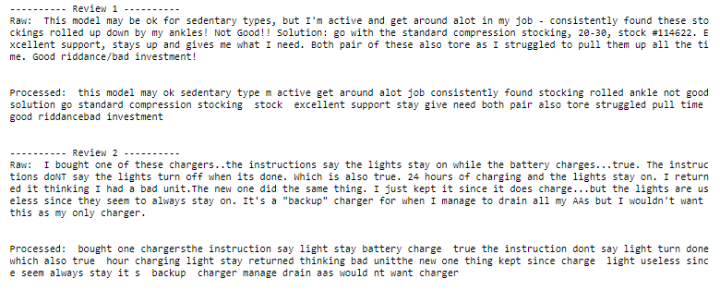
NLP Results
Notes:
Roman

Slide 12

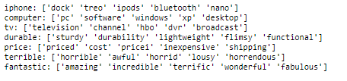
NLP Results
Lemmatization
Gensim Word2Vec.most_similar
Notes:
Roman

Slide 13
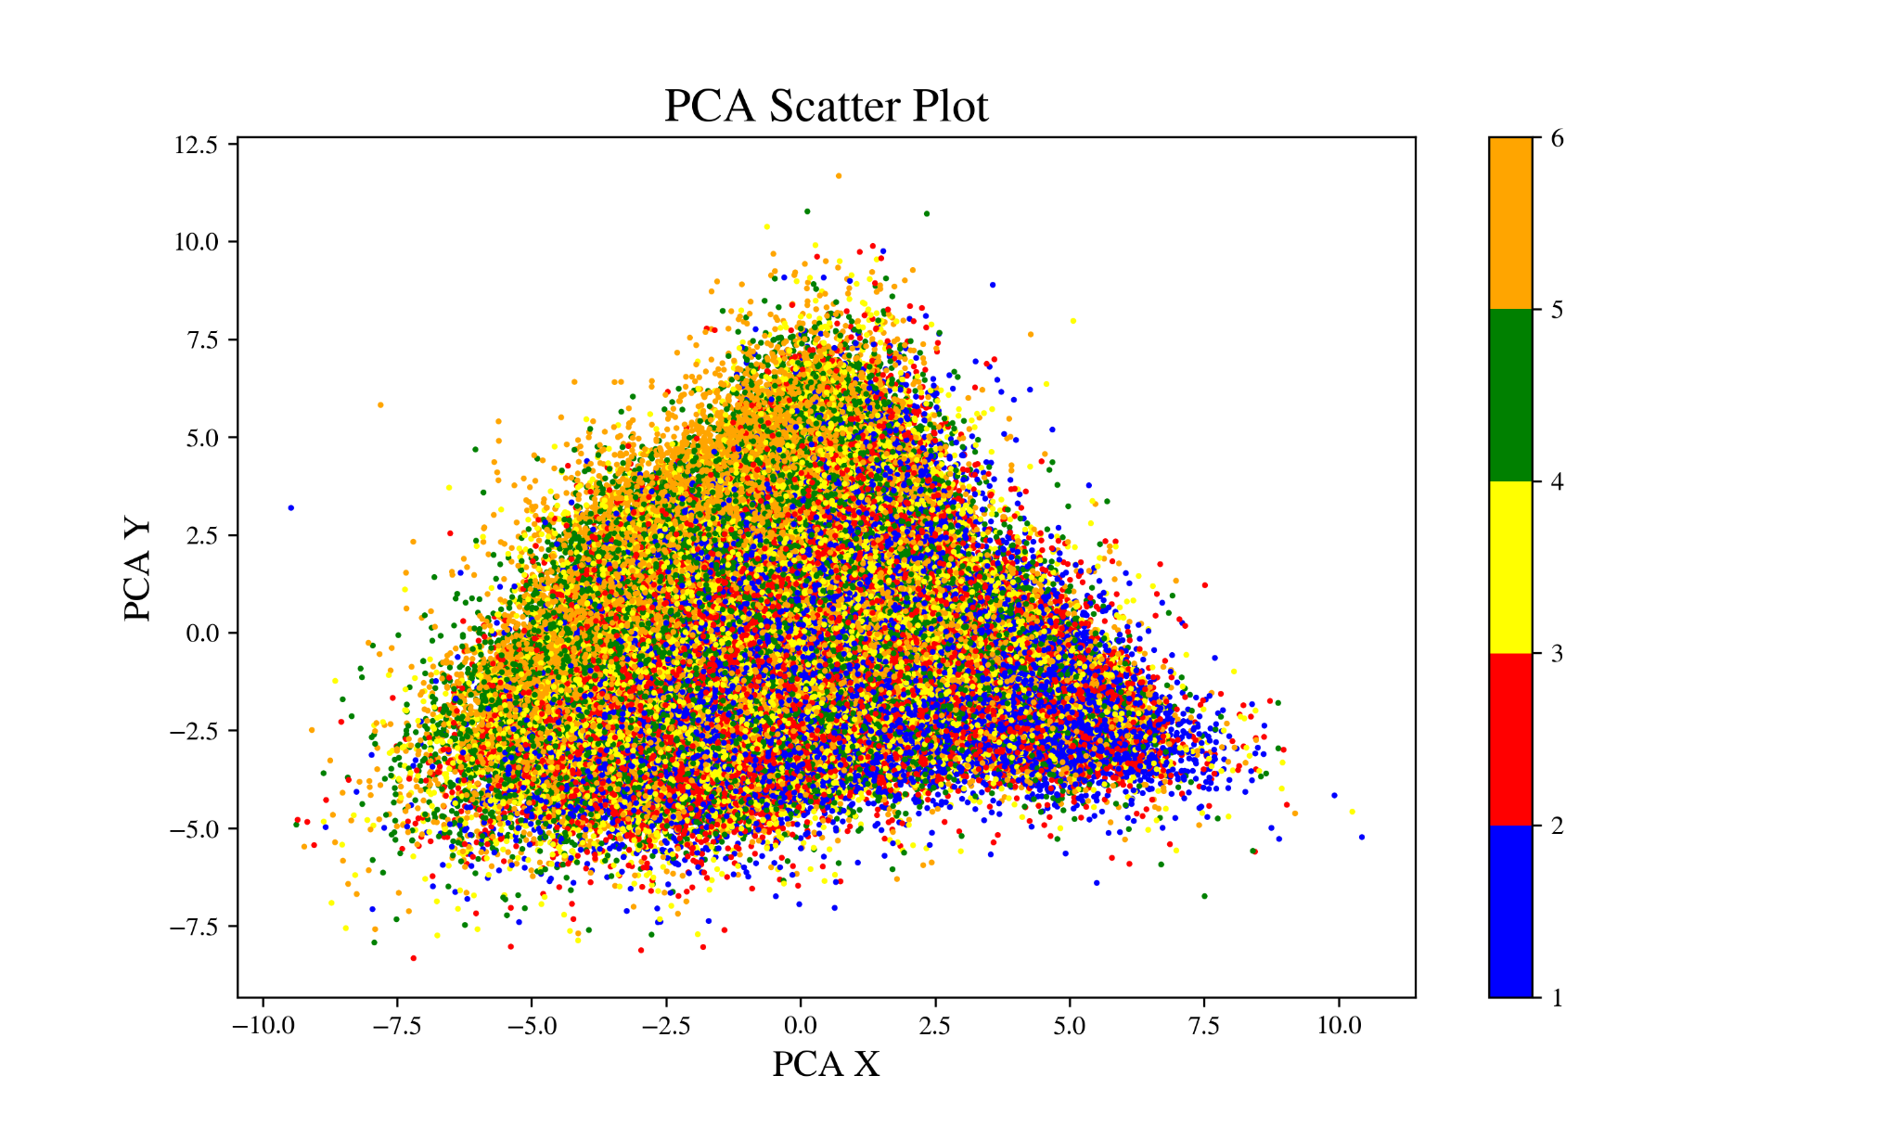
Results
Input Vector Shape: (300000, 100)
PCA Vector Shape:
(300000, 2)
Not Linearly Separable
Notes:
Roman

Slide 14
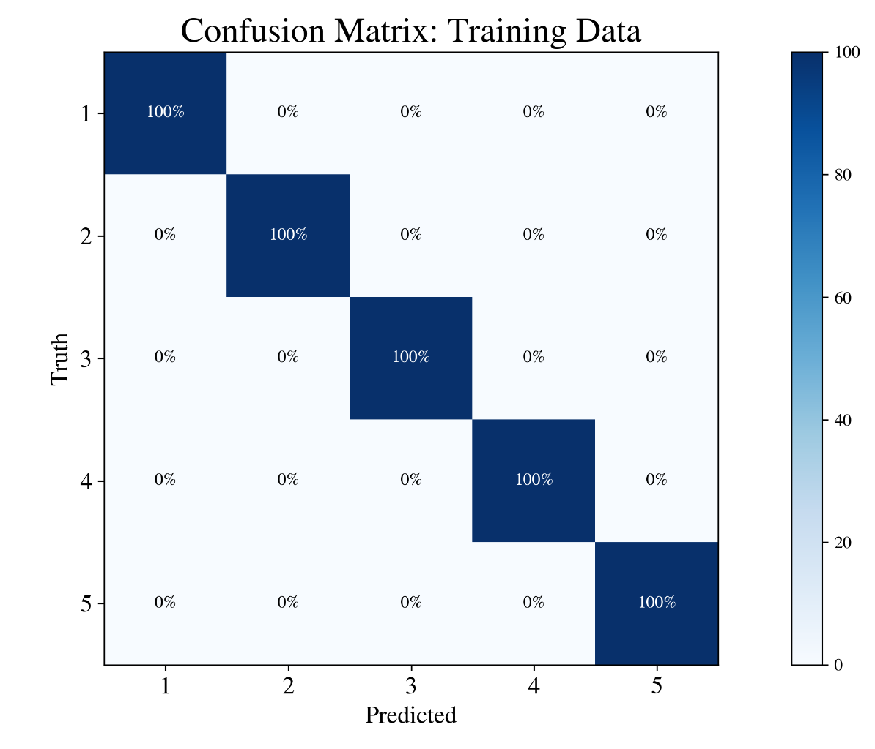
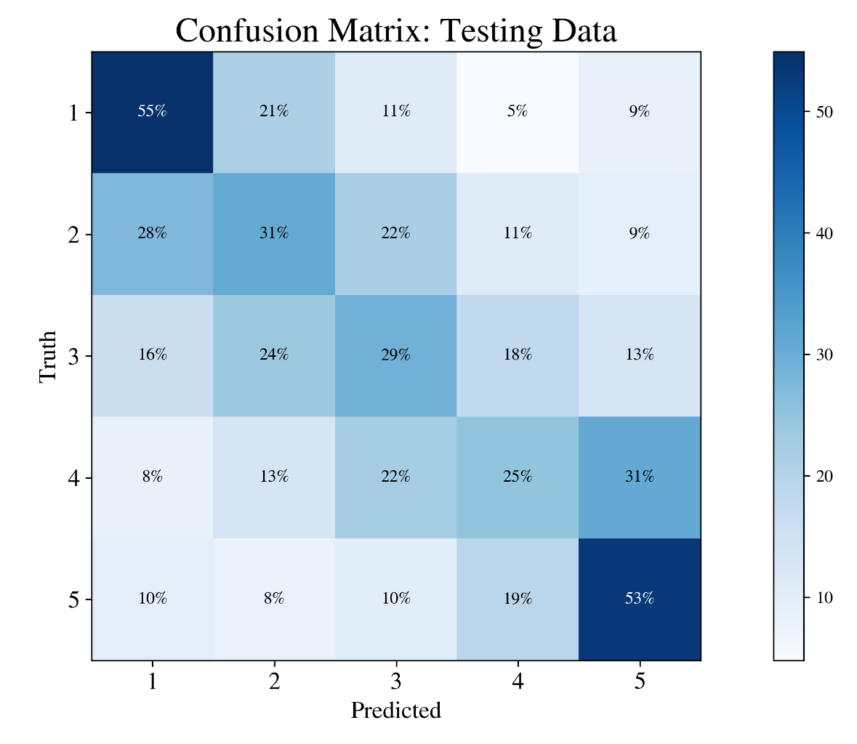
Random Forest
Testing Set Accuracy: 41.27%
Notes:
Roman

Slide 15
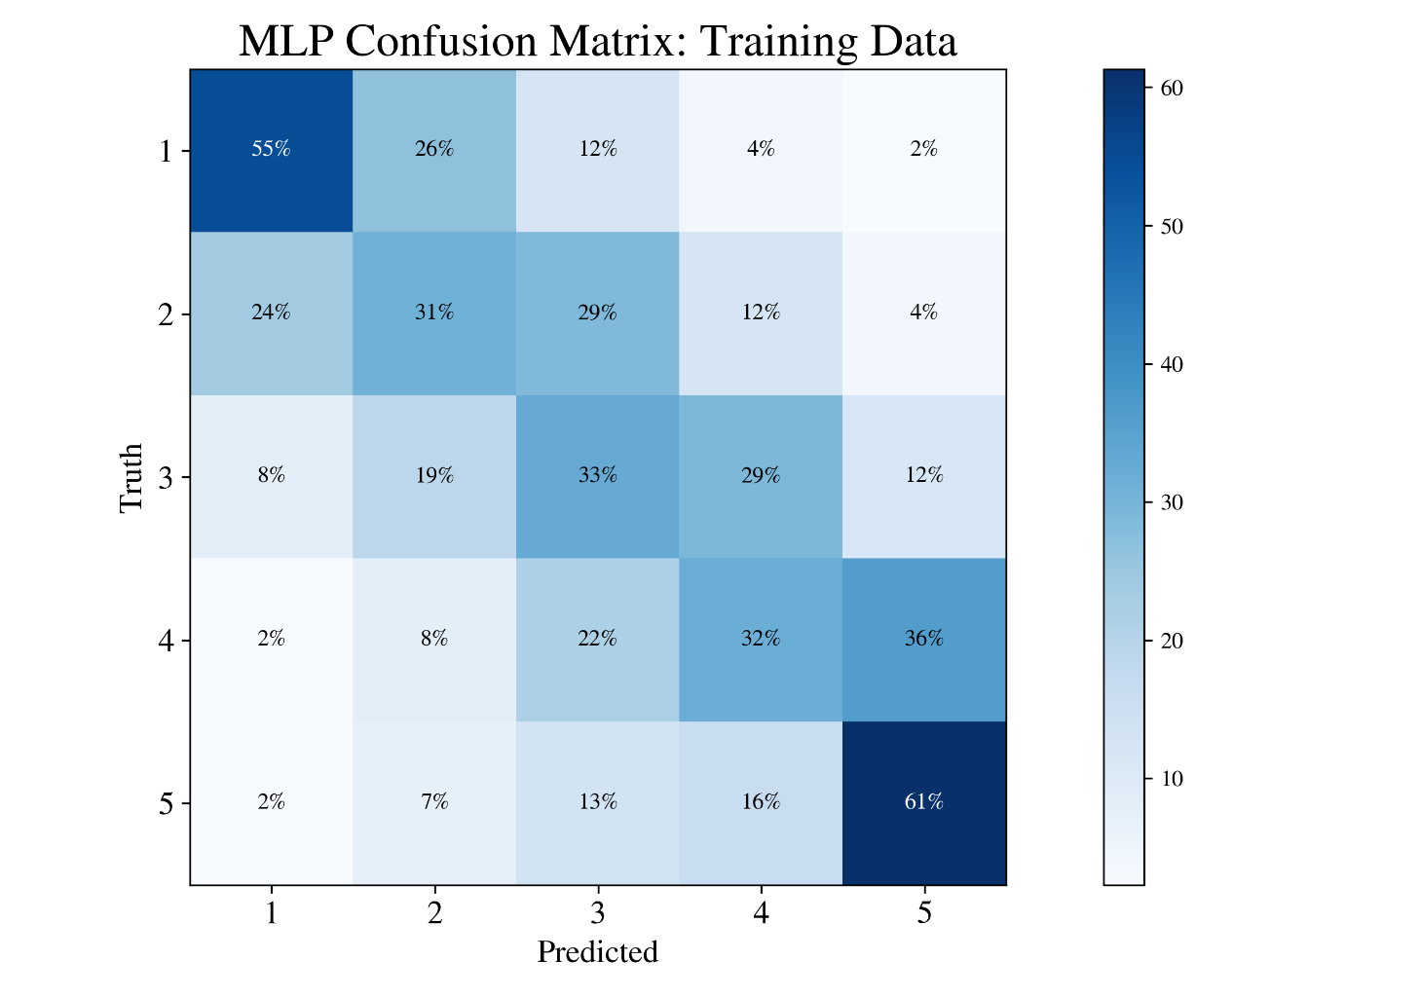

MLP
Testing Set Accuracy: 42.02%
Notes:
Roman

Slide 16
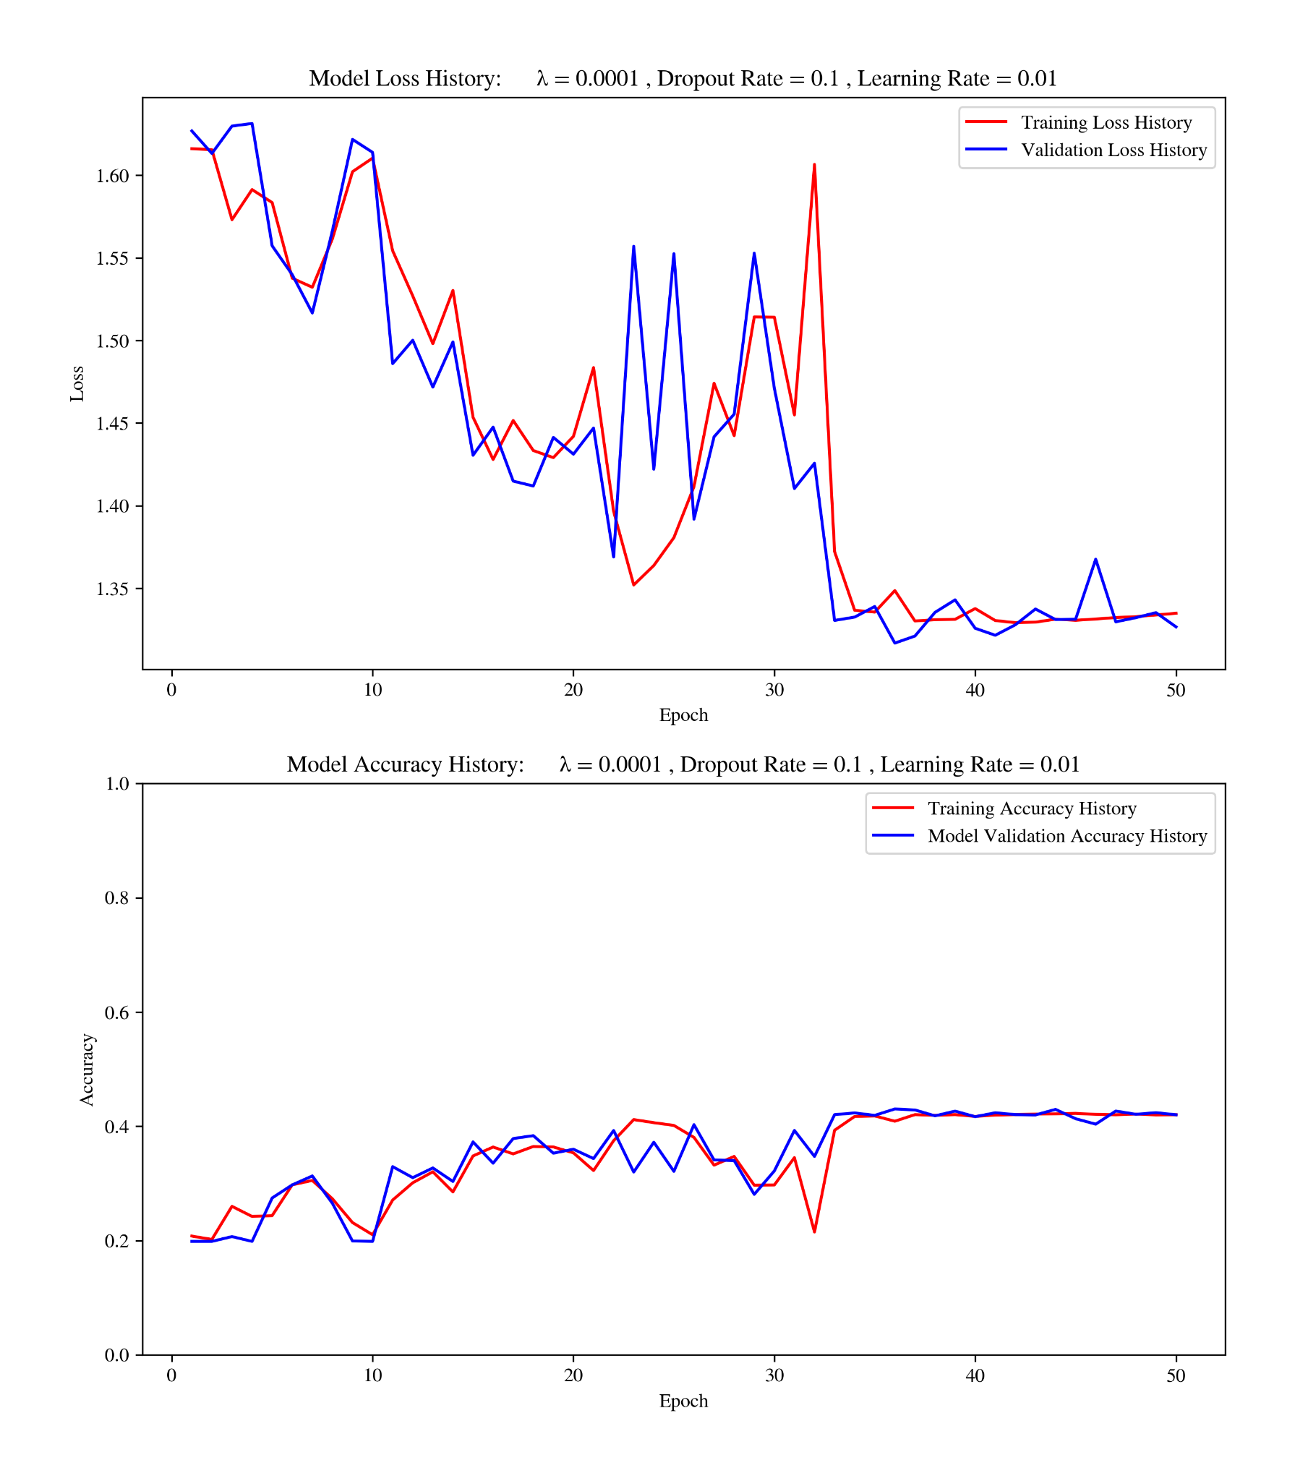
MLP
Notes:
Roman

Slide 17
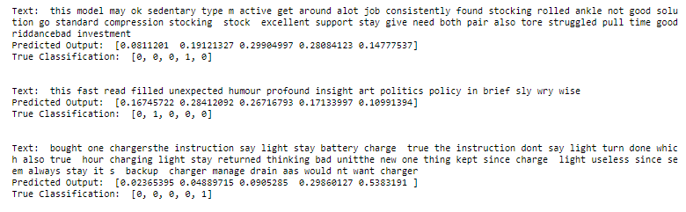
Results
N
Y
Y
Notes:
Roman

Slide 18
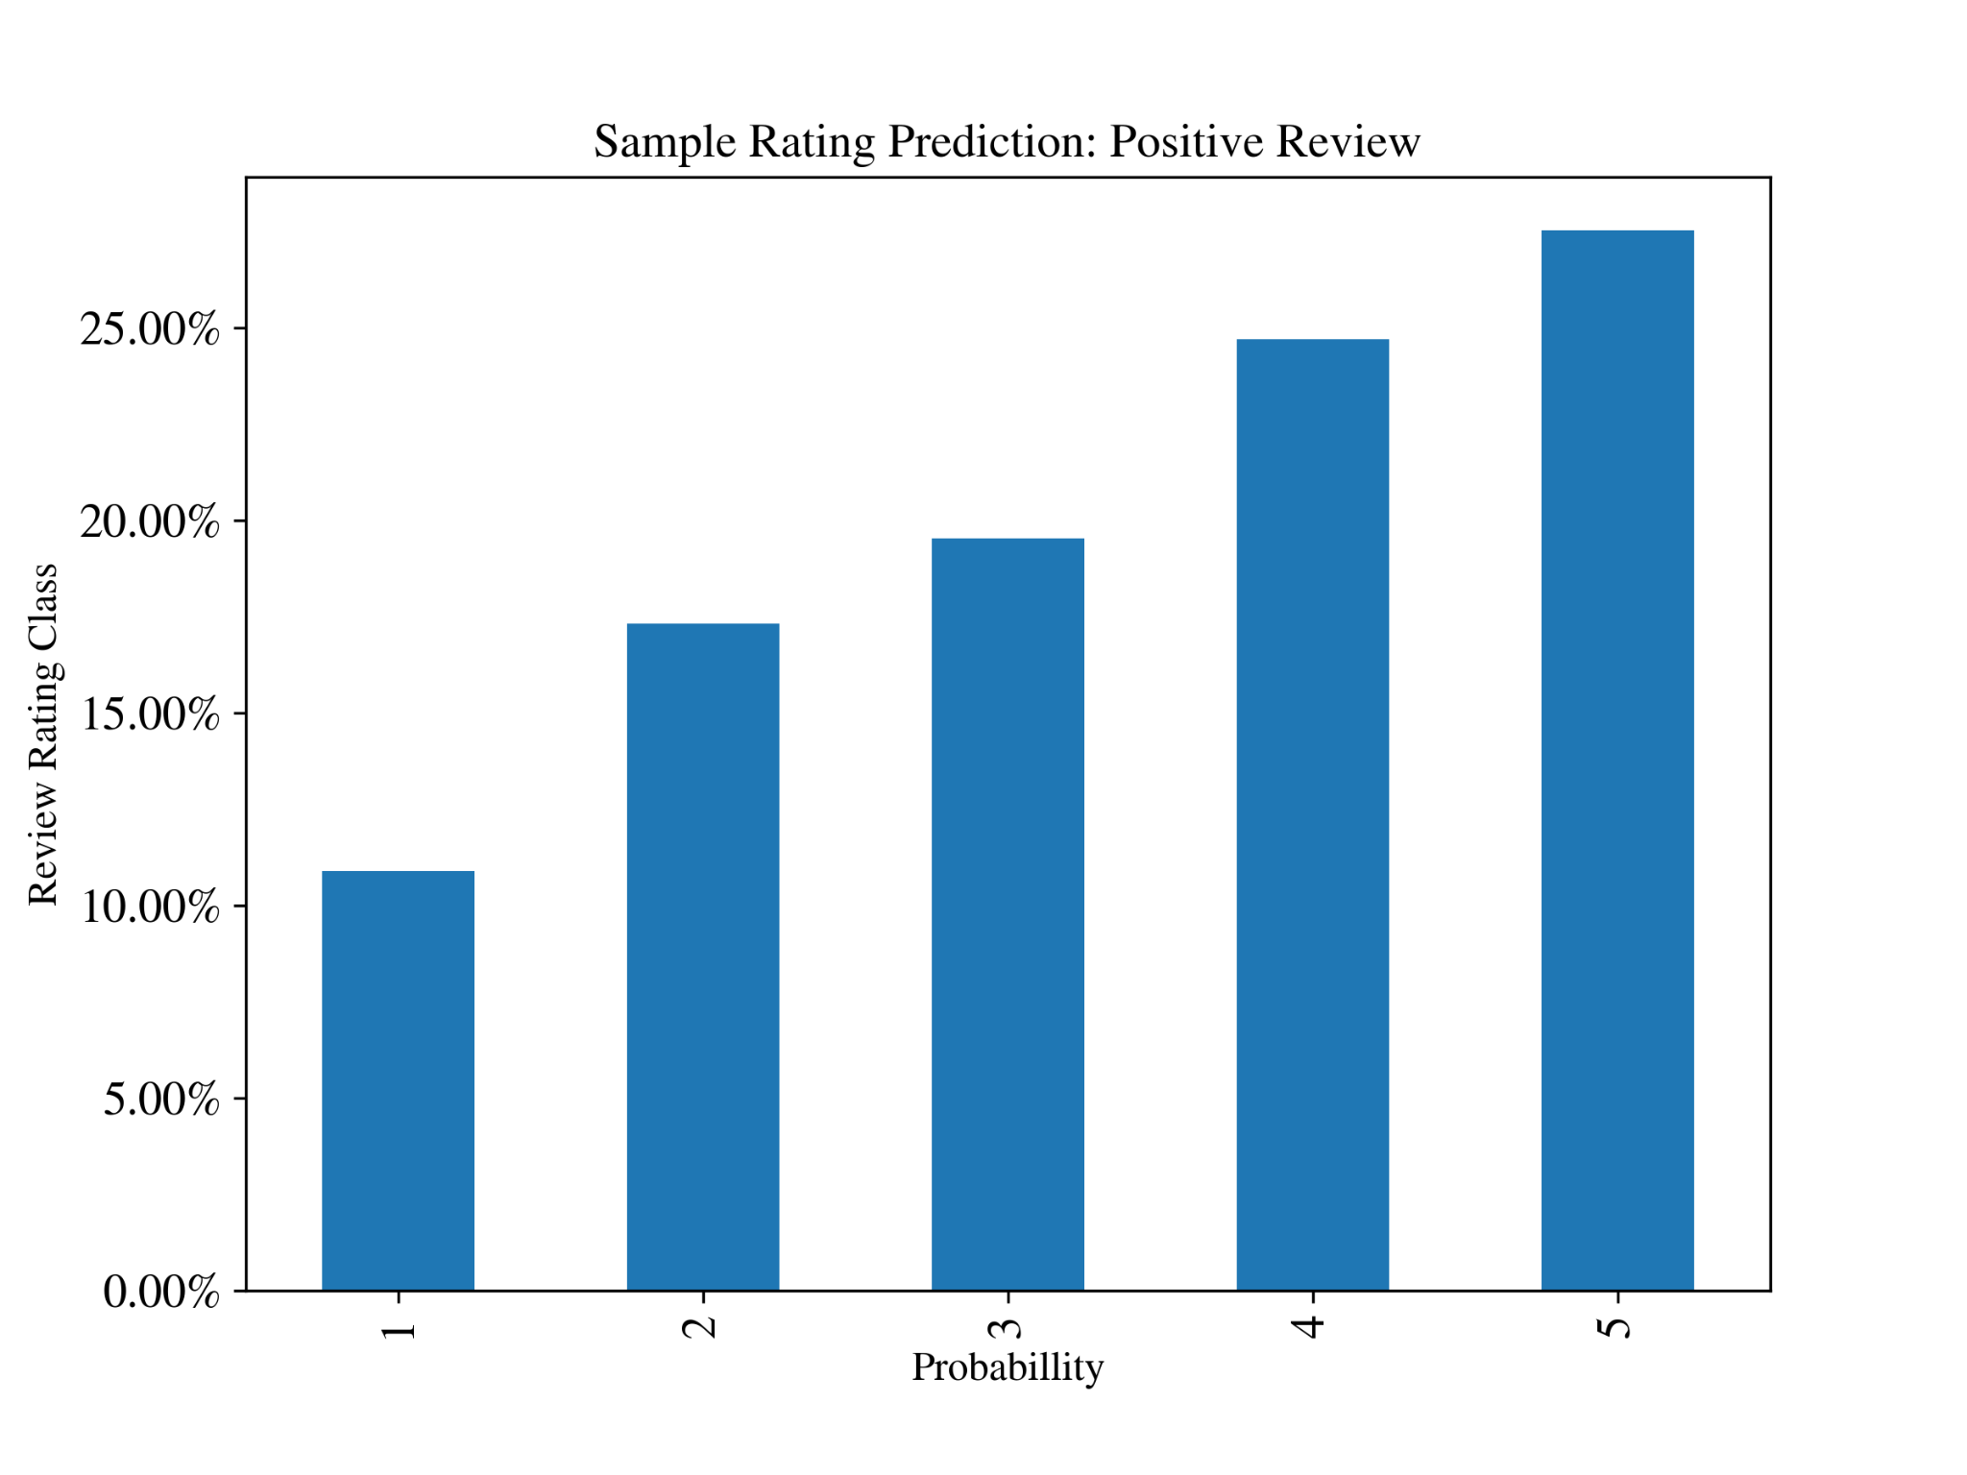
Results
Positive Review: 'I absolutely love this product, it is everything that I expected. The quality is unbeatable for the price. This product is amazing. I could not recommend this product more! ’
Notes:
Roman

Slide 19
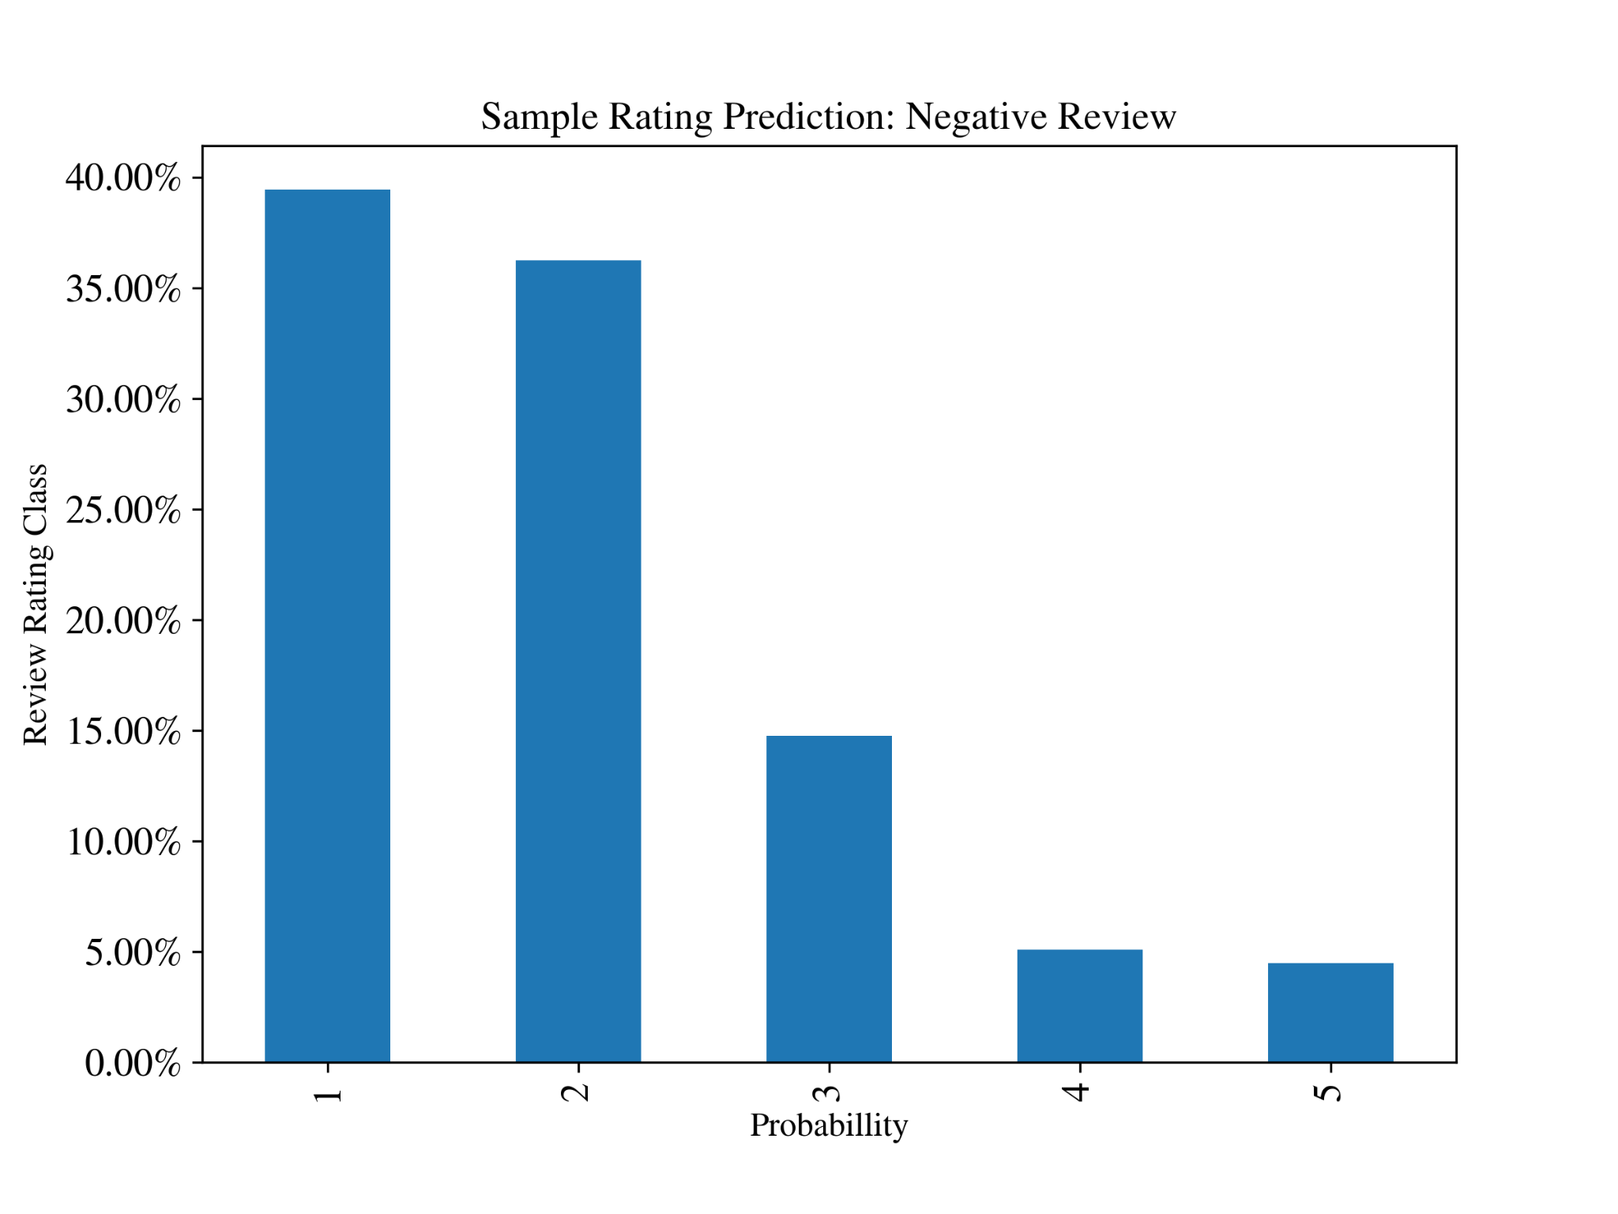
Results
Negative Review: ‘The package arrived damaged and the tv was fully broken. Do not buy this product, it is cheap and not made well. The tv is not very bright and makes a loud noise when you turn it on. The screen arrived broken and three days late.'
Notes:
Roman

Slide 20
Future Considerations
Use the Review Title Data Feature
More Layers for a Deeper MLP
Different Network Architecture (RNN, LSTM embedding layer)
More time for training
More computing power
Different Ensemble Techniques
Bagging/Boosting
Notes:
Roman

